Slide 1
Data Science
Session – 10
Date – 29th May, 2022

Slide 2
R - Bar Charts
A bar chart represents data in rectangular bars with length of the bar proportional to the value of the variable. R uses the function barplot() to create bar charts. R can draw both vertical and Horizontal bars in the bar chart. In bar chart each of the bars can be given different colors.
Syntax
The basic syntax to create a bar-chart in R is −
Following is the description of the parameters used −
H is a vector or matrix containing numeric values used in bar chart.
xlab is the label for x axis.
ylab is the label for y axis.
main is the title of the bar chart.
names.arg is a vector of names appearing under each bar.
col is used to give colors to the bars in the graph.
barplot(H,xlab,ylab,main, names.arg,col)

Slide 3
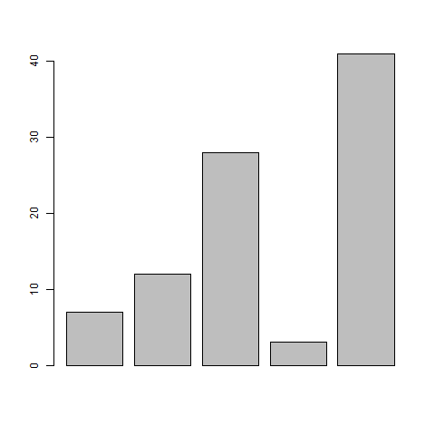
R - Bar Charts
Example
A simple bar chart is created using just the input vector and the name of each bar.
The below script will create and save the bar chart in the current R working directory.
# Create the data for the chart
H <- c(7,12,28,3,41)
# Give the chart file a name
png(file = "barchart.png")
# Plot the bar chart
barplot(H)
# Save the file
dev.off()

Slide 4
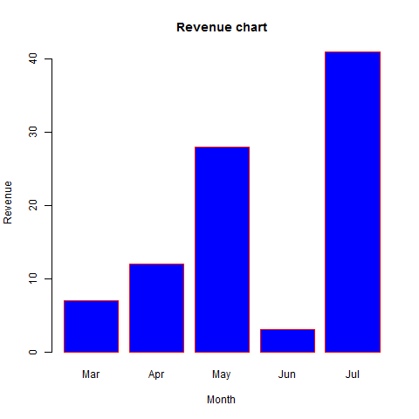
R - Bar Charts
Bar Chart Labels, Title and Colors
The features of the bar chart can be expanded by adding more parameters. The main parameter is used to add title. The col parameter is used to add colors to the bars. The args.name is a vector having same number of values as the input vector to describe the meaning of each bar.
Example
The below script will create and save the bar chart in the current R working directory.
# Create the data for the chart
H <- c(7,12,28,3,41)
M <- c("Mar","Apr","May","Jun","Jul")
# Give the chart file a name
png(file = "barchart_months_revenue.png")
# Plot the bar chart
barplot(H,names.arg=M,xlab="Month",ylab="Revenue",col="blue", main="Revenue chart",border="red")
# Save the file
dev.off()

Slide 5
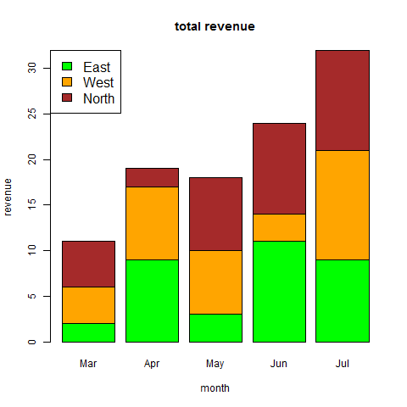
R - Bar Charts
Group Bar Chart and Stacked Bar Chart
We can create bar chart with groups of bars and stacks in each bar by using a matrix as input values.
More than two variables are represented as a matrix which is used to create the group bar chart and stacked bar chart.
# Create the input vectors.
colors = c("green","orange","brown")
months <- c("Mar","Apr","May","Jun","Jul")
regions <- c("East","West","North")
# Create the matrix of the values.
Values <- matrix(c(2,9,3,11,9,4,8,7,3,12,5,2,8,10,11), nrow = 3, ncol = 5, byrow = TRUE)
# Give the chart file a name png(file = "barchart_stacked.png")
# Create the bar chart
barplot(Values, main = "total revenue", names.arg = months, xlab = "month", ylab = "revenue", col = colors)
# Add the legend to the chart
legend("topleft", regions, cex = 1.3, fill = colors)
# Save the file
dev.off()

Slide 6
R - Boxplots
Boxplots are a measure of how well distributed is the data in a data set. It divides the data set into three quartiles. This graph represents the minimum, maximum, median, first quartile and third quartile in the data set. It is also useful in comparing the distribution of data across data sets by drawing boxplots for each of them.
Boxplots are created in R by using the boxplot() function.
Syntax
The basic syntax to create a boxplot in R is −
Following is the description of the parameters used −
x is a vector or a formula.
data is the data frame.
notch is a logical value. Set as TRUE to draw a notch.
varwidth is a logical value. Set as true to draw width of the box proportionate to the sample size.
names are the group labels which will be printed under each boxplot.
main is used to give a title to the graph.
boxplot(x, data, notch, varwidth, names, main)

Slide 7
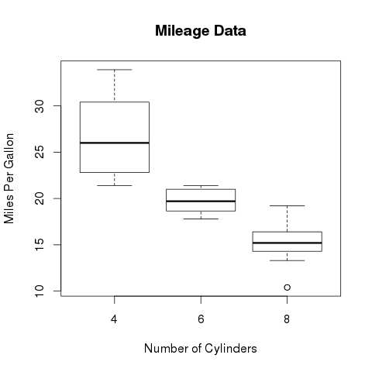
R - Boxplots
Example
We use the data set "mtcars" available in the R environment to create a basic boxplot. Let's look at the columns "mpg" and "cyl" in mtcars.
Creating the Boxplot
The below script will create a boxplot graph for the relation between mpg (miles per gallon) and cyl (number of cylinders).
# Give the chart file a name.
png(file = "boxplot.png")
# Plot the chart.
boxplot(mpg ~ cyl, data = mtcars, xlab = "Number of Cylinders", ylab = "Miles Per Gallon", main = "Mileage Data")
# Save the file.
dev.off()

Slide 8
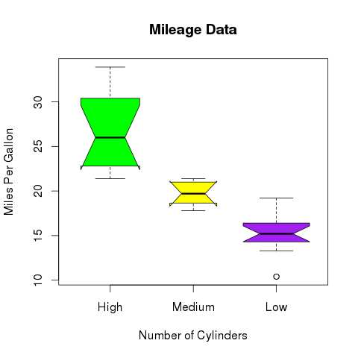
R - Boxplots
Boxplot with Notch
We can draw boxplot with notch to find out how the medians of different data groups match with each other.
The below script will create a boxplot graph with notch for each of the data group.
# Give the chart file a name.
png(file = "boxplot_with_notch.png")
# Plot the chart.
boxplot(mpg ~ cyl, data = mtcars,
xlab = "Number of Cylinders",
ylab = "Miles Per Gallon",
main = "Mileage Data",
notch = TRUE,
varwidth = TRUE,
col = c("green","yellow","purple"),
names = c("High","Medium","Low") )
# Save the file.
dev.off()

Slide 9
R - Histograms
A histogram represents the frequencies of values of a variable bucketed into ranges. Histogram is similar to bar chat but the difference is it groups the values into continuous ranges. Each bar in histogram represents the height of the number of values present in that range.
R creates histogram using hist() function. This function takes a vector as an input and uses some more parameters to plot histograms.
Syntax
The basic syntax for creating a histogram using R is −
Following is the description of the parameters used −
v is a vector containing numeric values used in histogram.
main indicates title of the chart.
col is used to set color of the bars.
border is used to set border color of each bar.
xlab is used to give description of x-axis.
xlim is used to specify the range of values on the x-axis.
ylim is used to specify the range of values on the y-axis.
breaks is used to mention the width of each bar.
hist(v,main,xlab,xlim,ylim,breaks,col,border)

Slide 10
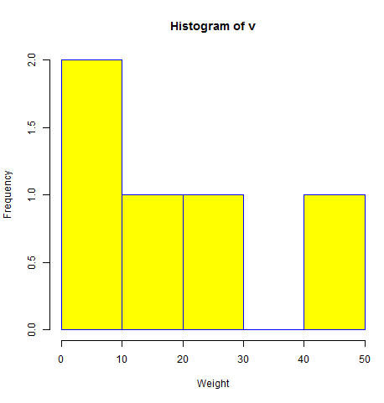
R - Histograms
Example
A simple histogram is created using input vector, label, col and border parameters.
The script given below will create and save the histogram in the current R working directory.
# Create data for the graph.
v <- c(9,13,21,8,36,22,12,41,31,33,19)
# Give the chart file a name.
png(file = "histogram.png")
# Create the histogram.
hist(v,xlab = "Weight",col = "yellow",border = "blue")
# Save the file.
dev.off()

Slide 11
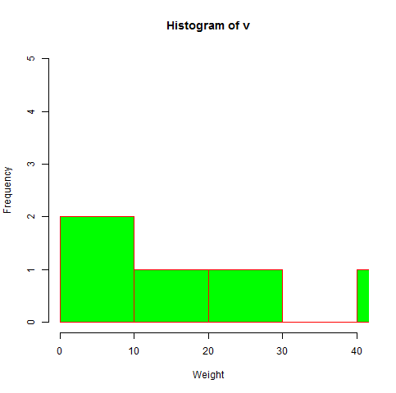
R - Histograms
Range of X and Y values
To specify the range of values allowed in X axis and Y axis, we can use the xlim and ylim parameters.
The width of each of the bar can be decided by using breaks.
# Create data for the graph.
v <- c(9,13,21,8,36,22,12,41,31,33,19)
# Give the chart file a name.
png(file = "histogram_lim_breaks.png")
# Create the histogram.
hist(v,xlab = "Weight",col = "green",border = "red", xlim = c(0,40), ylim = c(0,5), breaks = 5)
# Save the file.
dev.off()

Slide 12
R - Line Graphs
A line chart is a graph that connects a series of points by drawing line segments between them. These points are ordered in one of their coordinate (usually the x-coordinate) value. Line charts are usually used in identifying the trends in data.
The plot() function in R is used to create the line graph.
Syntax
The basic syntax to create a line chart in R is −
Following is the description of the parameters used −
v is a vector containing the numeric values.
type takes the value "p" to draw only the points, "l" to draw only the lines and "o" to draw both points and lines.
xlab is the label for x axis.
ylab is the label for y axis.
main is the Title of the chart.
col is used to give colors to both the points and lines.
plot(v,type,col,xlab,ylab)

Slide 13
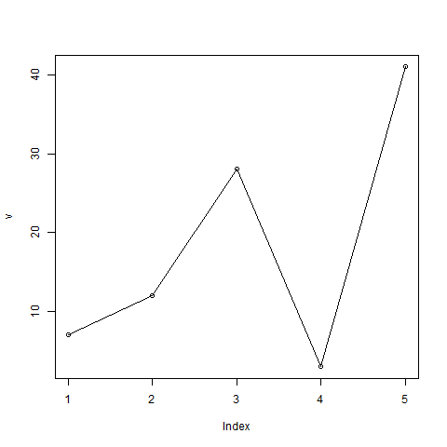
R - Line Graphs
Example
A simple line chart is created using the input vector and the type parameter as "O". The below script will create and save a line chart in the current R working directory.
# Create the data for the chart.
v <- c(7,12,28,3,41)
# Give the chart file a name.
png(file = "line_chart.jpg")
# Plot the bar chart.
plot(v,type = "o")
# Save the file.
dev.off()

Slide 14
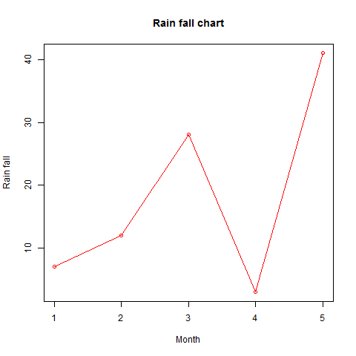
R - Line Graphs
Line Chart Title, Color and Labels
The features of the line chart can be expanded by using additional parameters. We add color to the points and lines, give a title to the chart and add labels to the axes.
Example
# Create the data for the chart.
v <- c(7,12,28,3,41)
# Give the chart file a name.
png(file = "line_chart_label_colored.jpg")
# Plot the bar chart.
plot(v,type = "o", col = "red", xlab = "Month", ylab = "Rain fall", main = "Rain fall chart")
# Save the file.
dev.off()

Slide 15
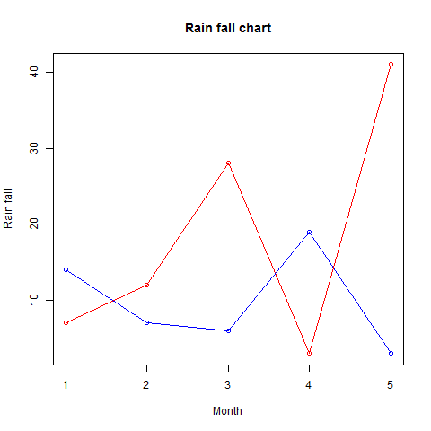
R - Line Graphs
Multiple Lines in a Line Chart
More than one line can be drawn on the same chart by using the lines()function.
After the first line is plotted, the lines() function can use an additional vector as input to draw the second line in the chart,
# Create the data for the chart.
v <- c(7,12,28,3,41)
t <- c(14,7,6,19,3)
# Give the chart file a name.
png(file = "line_chart_2_lines.jpg")
# Plot the bar chart.
plot(v,type = "o", col = "red", xlab = "Month", ylab = "Rain fall", main = "Rain fall chart")
lines(t, type = "o", col = "blue")
# Save the file.
dev.off()

Slide 16
R - Scatterplots
Scatterplots show many points plotted in the Cartesian plane. Each point represents the values of two variables. One variable is chosen in the horizontal axis and another in the vertical axis.
The simple scatterplot is created using the plot() function.
Syntax
The basic syntax for creating scatterplot in R is −
Following is the description of the parameters used −
x is the data set whose values are the horizontal coordinates.
y is the data set whose values are the vertical coordinates.
main is the tile of the graph.
xlab is the label in the horizontal axis.
ylab is the label in the vertical axis.
xlim is the limits of the values of x used for plotting.
ylim is the limits of the values of y used for plotting.
axes indicates whether both axes should be drawn on the plot.
plot(x, y, main, xlab, ylab, xlim, ylim, axes)

Slide 17
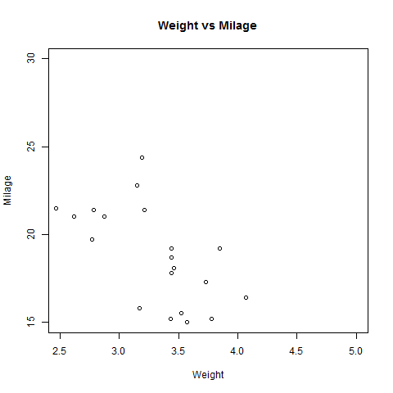
R - Scatterplots
Example
We use the data set "mtcars" available in the R environment to create a basic scatterplot. Let's use the columns "wt" and "mpg" in mtcars.
Creating the Scatterplot
The below script will create a scatterplot graph for the relation between wt(weight) and mpg(miles per gallon).
# Get the input values.
input <- mtcars[,c('wt','mpg’)]
# Give the chart file a name.
png(file = "scatterplot.png")
# Plot the chart for cars with weight between 2.5 to 5 and mileage between 15 and 30.
plot(x = input$wt,y = input$mpg,
xlab = "Weight", ylab = "Milage",
xlim = c(2.5,5), ylim = c(15,30),
main = "Weight vs Milage" )
# Save the file.
dev.off()

Slide 18
R - Scatterplots
Scatterplot Matrices
When we have more than two variables and we want to find the correlation between one variable versus the remaining ones we use scatterplot matrix. We use pairs() function to create matrices of scatterplots.
Syntax
The basic syntax for creating scatterplot matrices in R is −
Following is the description of the parameters used −
formula represents the series of variables used in pairs.
data represents the data set from which the variables will be taken.
pairs(formula, data)

Slide 19
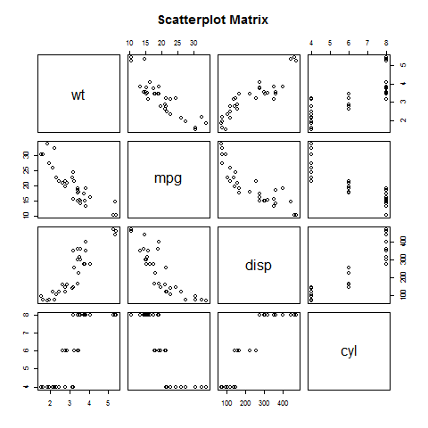
R - Scatterplots
Example
Each variable is paired up with each of the remaining variable. A scatterplot is plotted for each pair.
# Give the chart file a name.
png(file = "scatterplot_matrices.png")
# Plot the matrices between 4 variables giving 12 plots. # One variable with 3 others and total 4 variables.
pairs(~wt+mpg+disp+cyl,data = mtcars,
main = "Scatterplot Matrix")
# Save the file.
dev.off()

